Slide 1

#LifeKoKaroLift
Post-Graduate Diploma in ML/AI

Slide 2



Course : Machine Learning
Lecture On : Pre Assignment - DRL
Instructor : Manish Kumar

Slide 3

Session - Agenda
Deep Q-learning
Different architectures of deep Q-leaning
Group Case study ☺

Slide 4


Group Case study
Goals
Create the environment
Build an agent that learns to pick the best request using DQN
Track Convergence

Slide 5
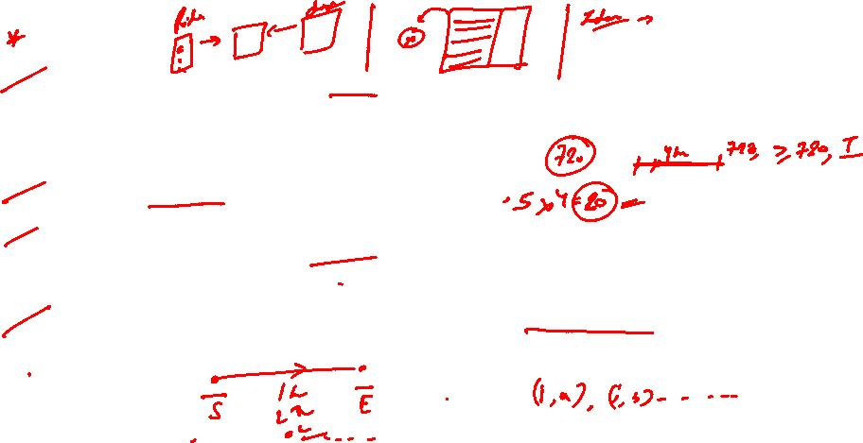
MDP
Assumptions
1. The taxis are electric cars. It can run for 30 days non-stop, i.e., 24*30 hrs. Then it needs to recharge itself. If the cab-driver is completing his trip at that time, he’ll finish that trip and then stop for recharging. So, the terminal state is independent of the number of rides covered in a month, it is achieved as soon as the cab-driver crosses 24*30 hours.
2. There are only 5 locations in the city where the cab can operate.
3. All decisions are made at hourly intervals. We won’t consider minutes and seconds for this project. So for example, the cab driver gets requests at 1:00 pm, then at 2:00 pm, then at 3:00 pm and so on. So, he can decide to pick among the requests only at these times. A request cannot come at (say) 2.30 pm.
4. The time taken to travel from one place to another is considered in integer hours (only) and is dependent on the traffic. Also, the traffic is dependent on the hour-of-the-day and the day-of-the-week.

Slide 6
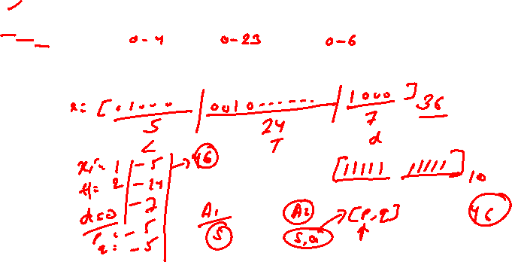
MDP
State
The state space is defined by the driver’s current location along with the time components (hour-of the-day and the day-of-the-week). A state is defined by three variables:
𝑠 = 𝑋𝑖𝑇𝑗𝐷𝑘 𝑤ℎ𝑒𝑟𝑒 𝑖 = 0 … 𝑚 − 1;𝑗 = 0 … .𝑡 − 1; 𝑘 = 0 … . . 𝑑 − 1
Where 𝑋𝑖 represents a driver’s current location, 𝑇𝑗 represents time component (more specifically hour of the day), 𝐷𝑘 represents the day of the week
• Number of locations: m = 5
• Number of hours: t = 24
• Number of days: d = 7
A terminal state is achieved when the cab completes his 30 days, i.e., an episode is 30 days long.

Slide 7
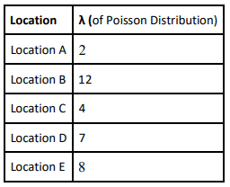
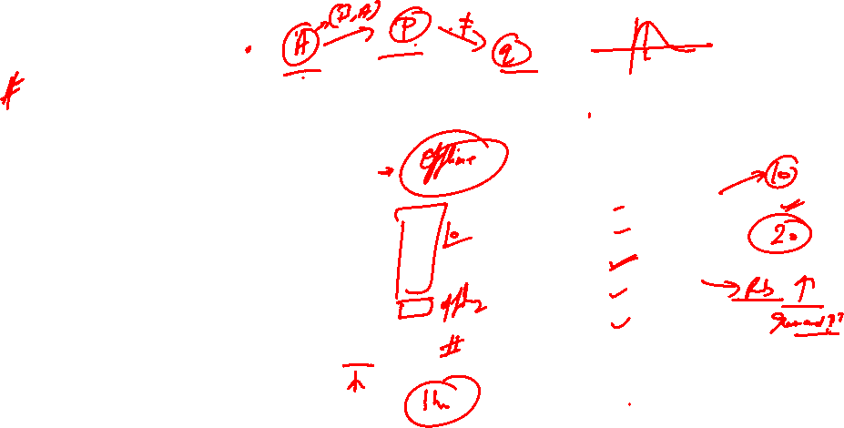
MDP
Actions
An action is represented by the tuple (pick-up, drop) location. In a general scenario, the number of requests the cab-driver can get at any state is not the same. We can model the number of requests as follows:
For each location, you can sample the number of requests from a Poisson distribution using the mean λ defined for each location
Note : Apart from these requests, the driver always has the option to go ‘offline’ (accept no ride). The no-ride action just moves the time component by 1 hour. So, you need to append (0,0) action to the customer requests
The upper limit on these customers’ requests (𝑝, 𝑞) is 15.

Slide 8
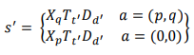
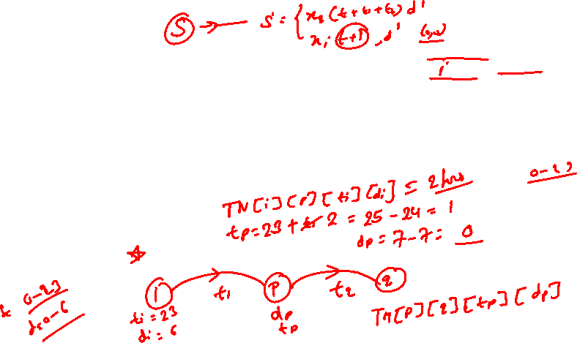
MDP
State Transition
Given the current state 𝑠 = 𝑋𝑖𝑇𝑗𝐷𝑘, the next state 𝑠’ will be as following:
You can calculate the total time taken to reach from one point to other from the Time Matrix (calculated basis the historical data) provided to you in the zip file. You don't need to learn a distribution of the time taken; all possible values of (pick up, drop, t, d) are available in the ‘TM.npy’ file, you simply need to look them up.
Time Matrix is a 4-D matrix. The 4 dimensions are as below:
• Start location
• End location
• Time-of-the-day
• Day-of-the-week

Slide 9
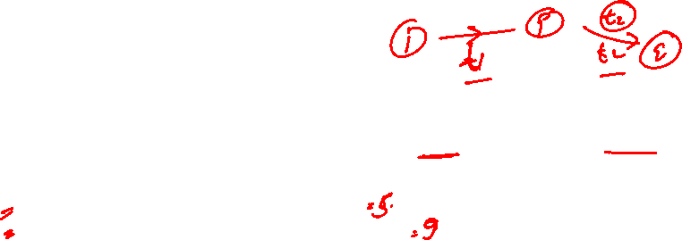
MDP
Reward
Your objective is to maximize the profit of a driver.
𝐶𝑓 = Amount of battery consumed per hour
𝑅𝑘 = Revenue obtained for every hour of the ride.
𝑋𝑖 represents a driver’s current location, 𝑇𝑗 represents time component (more specifically hour of the day), 𝐷𝑘 represents the day of the week, 𝑝 represents the pickup location and 𝑞 represents the drop location.

Slide 10
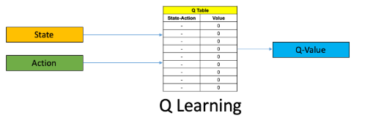
Q-Learning
In Q-learning, you do max-update. After taking action a from state s, you get an immediate reward of r and land in a new state s′. From s′, you take the most greedy action, i.e., the action with the highest q-value.

Slide 11
Why Deep Q - Learning
Q-learning is a simple yet quite powerful algorithm to create a good agent. This helps the agent figure out exactly which action to perform.
But what if this Q-table is too long? Things will quickly get out of control!
And what about the new states?
This presents two problems:
First, the amount of memory required to save and update that table would increase as the number of states increases
Second, the amount of time required to explore each state to create the required Q-table would be unrealistic
So, what if we approximate these Q-values with machine learning models such as a neural network? Well, this was the idea behind DeepMind’s algorithm ☺

Slide 12



Poll 2
Suppose the probability of taking an action as 0.1 in the current state. Which action did you take in the 'current state’?
S = [0, 6, 13, 2] Epsilon = 0.2
The Q-values for the next state for the 3 possible actions are [30, 60, 50]
( A ) 1
( B ) 2
( C ) 3
( D ) Any of the above
Practice in teams of 4 students
Industry expert mentoring to learn better
Get personalised feedback for improvements
14-11-2021
11

Slide 13
Poll 2 (Solution)
Suppose the probability of taking an action as 0.1 in the current state. Which action did you take in the 'current state’?
S = [0, 6, 13, 2] Epsilon = 0.2
The Q-values for the next state for the 3 possible actions are [30, 60, 50]
( A ) 1
( B ) 2
( C ) 3
( D ) Any of the above
Practice in teams of 4 students
Industry expert mentoring to learn better
Get personalised feedback for improvements
Since the prob 0.1 is lesser than the value of ε=0.2, we will take random action.
14-11-2021
11

Slide 14
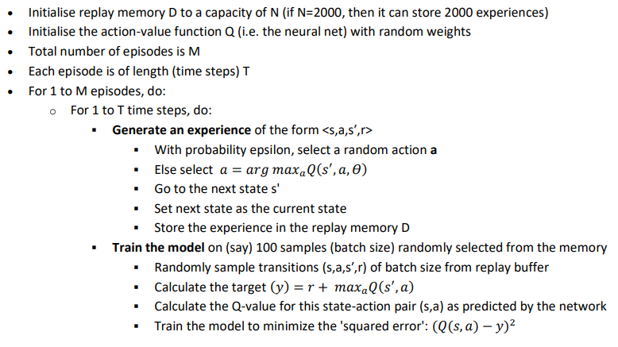
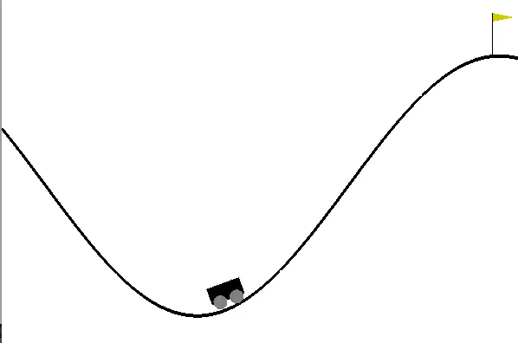
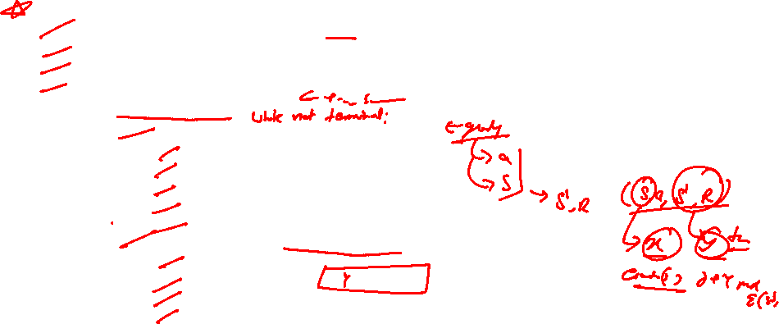
Q-learning pseudocode

Slide 15
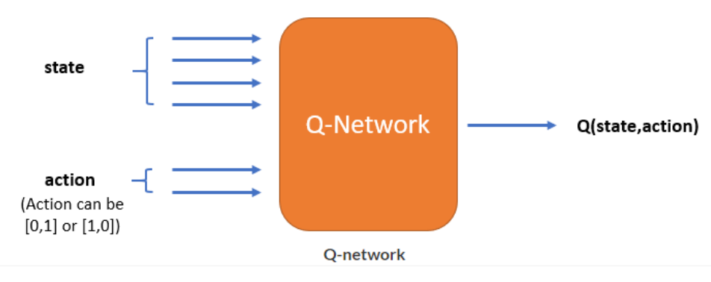
Architectures of Deep Q Learning: Architecture 1
Disadvantage:
Suppose the state is represented by a vector of size 4 and for every possible state, there can be 2 actions. To find 𝑚𝑎𝑥𝑎𝑄(𝑠 ′ , 𝑎), you have to do feedforward 2 times, one for each action and find the Q-value. Then take the action for which Q-value is the maximum.

Slide 16
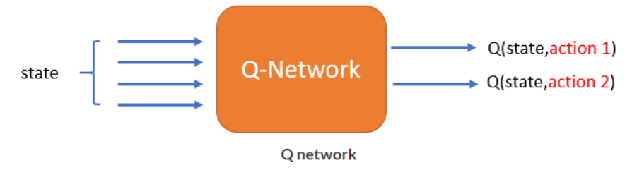
Architectures of Deep Q Learning: Architecture 2
Advantage:
The advantage here is that, just by giving state as the input to the NN, you will get Q(s, a) for each action, so you have to run the NN just once for every state. Take the action for which Q(s, a) is the maximum.

Slide 17
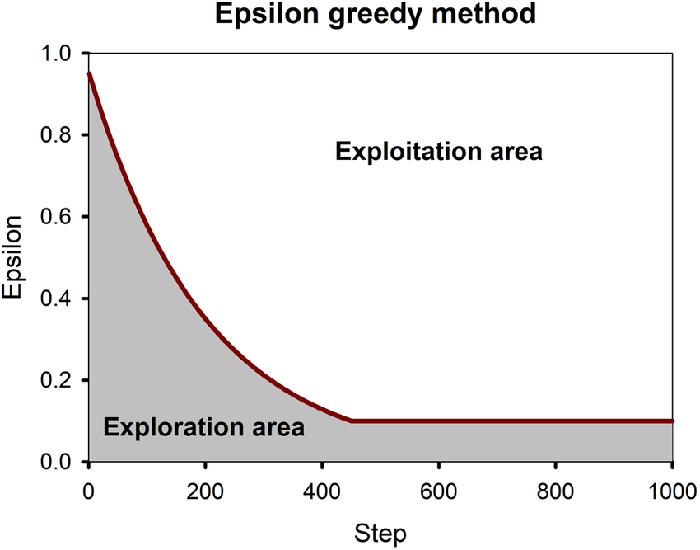
Epsilon-Greedy
A common approach to balancing the exploitation-exploration tradeoff is the epsilon- or e-greedy algorithm.
Greedy here means what you probably think it does. After an initial period of exploration (for example 1000 trials), the algorithm greedily exploits the best option k, e percent of the time. For example, if we set e=0.05, the algorithm will exploit the best variant 95% of the time and will explore random alternatives 5% of the time.

Slide 18
Thank You!

